Slide 1
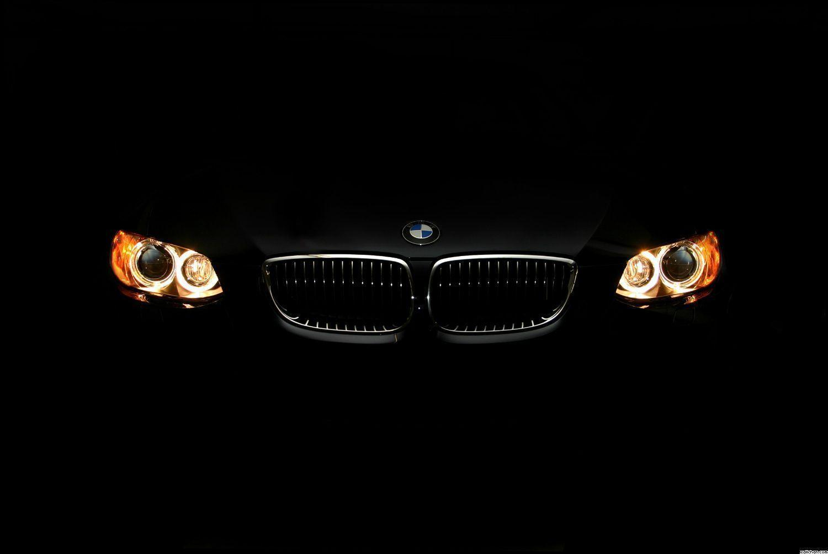


x
Part A
of
Infrastructure for BMW Test Cars Display System
Developed by:
Daher Daher & Vivian Lawin
Supervisor:
Boaz Mizrachi
(FOUNDER & CTO @ Tactile Mobility)

Slide 2
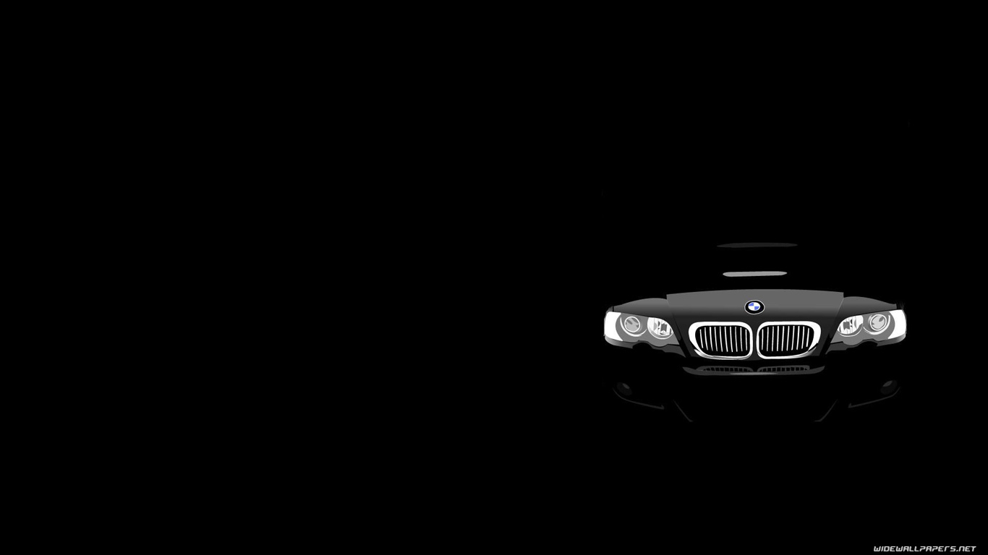
“The Gift of Truth excels all other Gifts.”
― Buddha
if ( yourFriends.areRich() )
“The Gift of a BMW car excels all other Gifts.”
else
“The Gift of Truth excels all other Gifts.”
― Daher

Slide 3
Motivation
In order to enhance and improve the driving experience in BMW cars in general (and BMW’s Autonomous cars in particular), drivers and car testers must understand and feel not only the condition of the environment and the traffic, but also the condition of the road.
Fraction
Humidity
Grip
Temperature and more.

Slide 4
Do we really need it?
Car testing is very essential, and the more the testing procedure is efficient the more the results are reliable, and time is saved.
How about “safety”?
Both advantages are highly desired in the era of new technology, and especially in the emerging field of AI and autonomous cars.

Slide 5
Main Concept
Two independent parts communicate one another in order to transfer data.
Transmitter - receives file of sensors data streams, parsing it and transmitting the data to the receiver.
Receiver - application installed in the car’s dashboard display system. On receiving data, the receiver parses, filters and enqueues the data for further processing by the application
Each of the above roles are independent and can be replaces and improved independently.

Slide 6
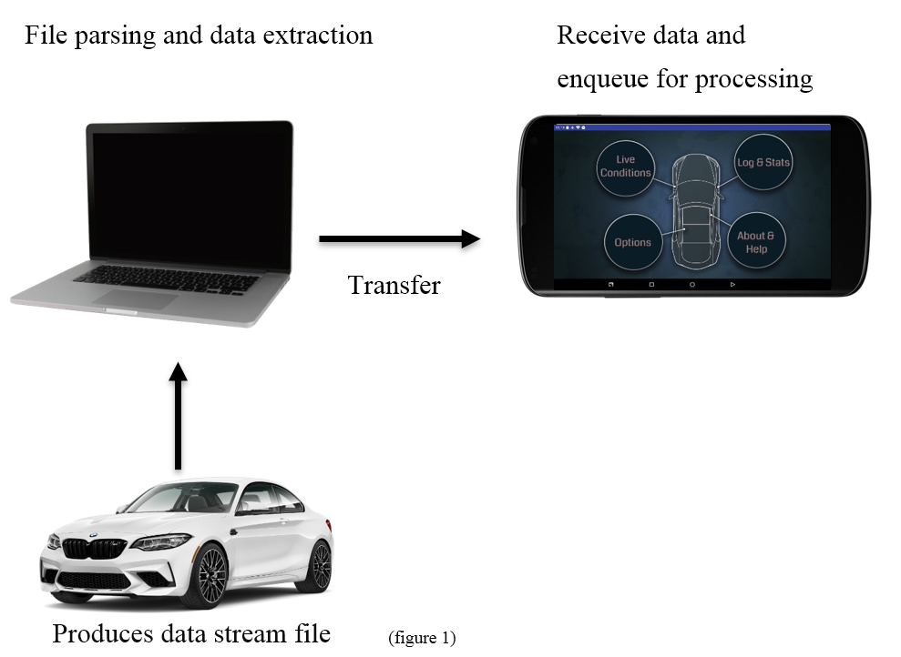
Main Concept
Two independent parts:
Transmitter – Java App
Receiver – Android App

Slide 7
Features List
Easy-to-use application.
Support multiple graphs (Up to 3 graphs at a time).
Choose different configurations (Resolution, Max value, Color…).
Support logging and data recording (internal memory file and in UI).
Time axis scaling.
Different appearance theme.

Slide 8
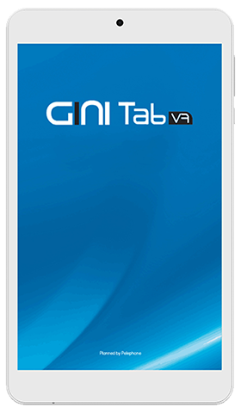
Technology - Display screen
Device: GINI Tab V7
Android Nougat 7
22.9% of all android users
Screen size: 7”
Screen resolution: 1280x800

Slide 9
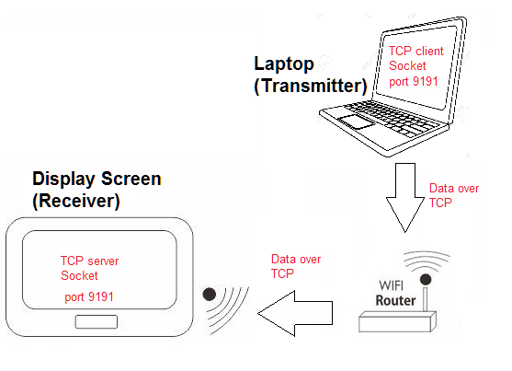
Technology – Data Transfer
How do the Transmitter and Receiver communicate?
TCP networking protocol
TCP Sockets.
Same WI-FI network
Receiver – Server
Transmitter – Client.
Open TCP sockets on the same port allowing them to communicate.

Slide 10



Technology – Development tools
Software & IDE’S
Android Studio IDE 3.3
Java over Windows OS
Eclipse Oxygen 4.7
Java over Windows OS
Graphics
Adobe Photoshop CC 2015
Adobe Illustrator CC 2015

Slide 11
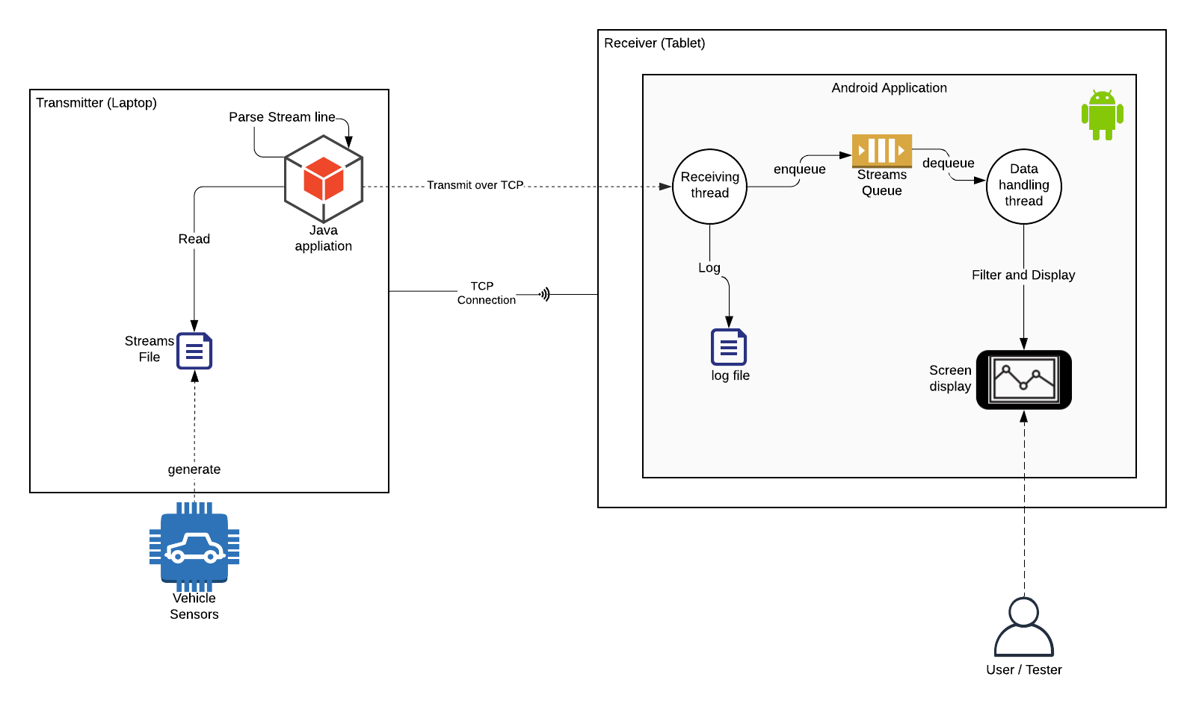
High Level Design

Slide 12
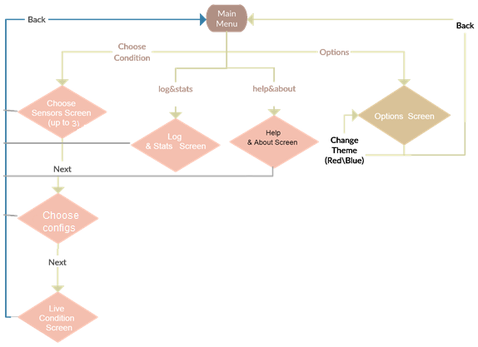
User Interface

Slide 13
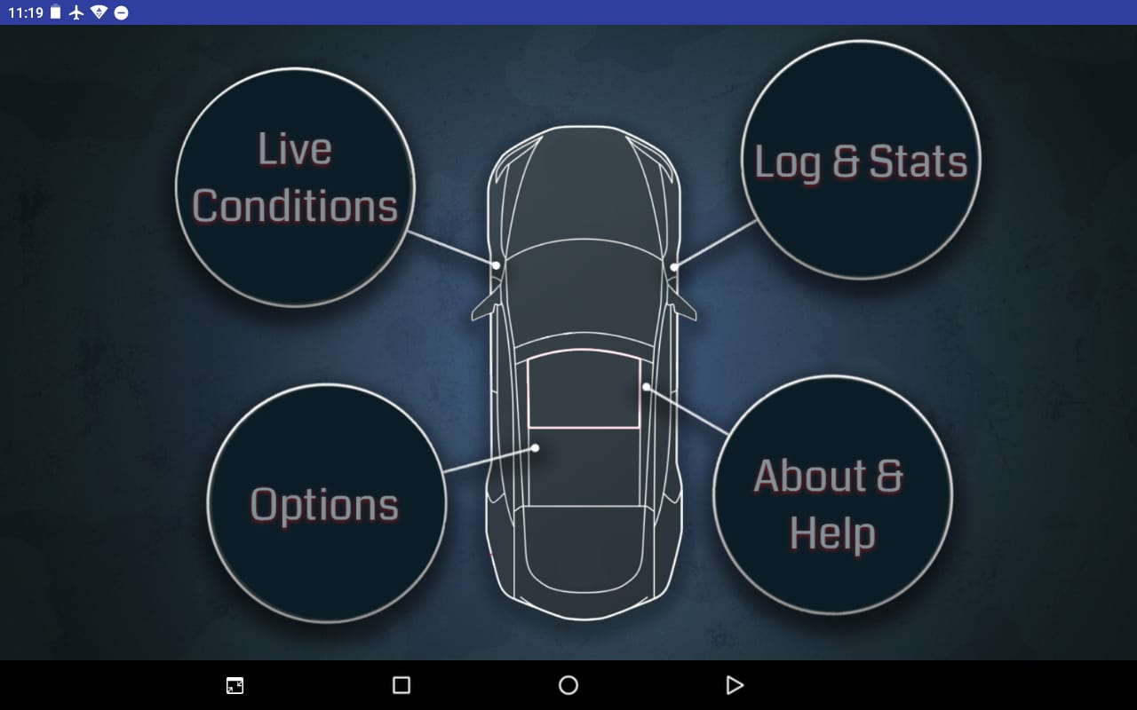
User Interface – Screens & Usage
Main Page
App’s home page
List of options

Slide 14
Screens & Usage –
Live Conditions

Slide 15
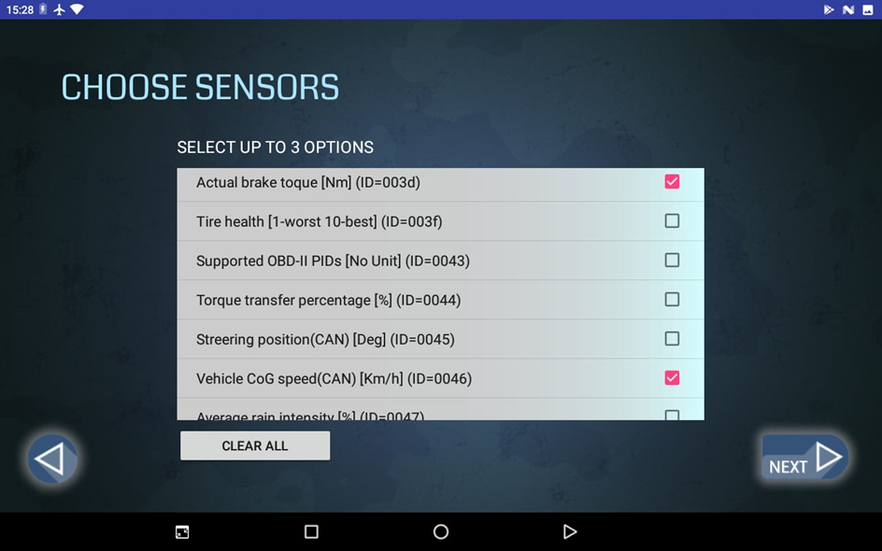
Live Conditions – Choose Sensors
Choosing which sensors to be displayed
User can choose up to 3 sensors to be shown at the same time.
Users cannot proceed to the next screen (using the next button) unless at least one option was chosen.

Slide 16
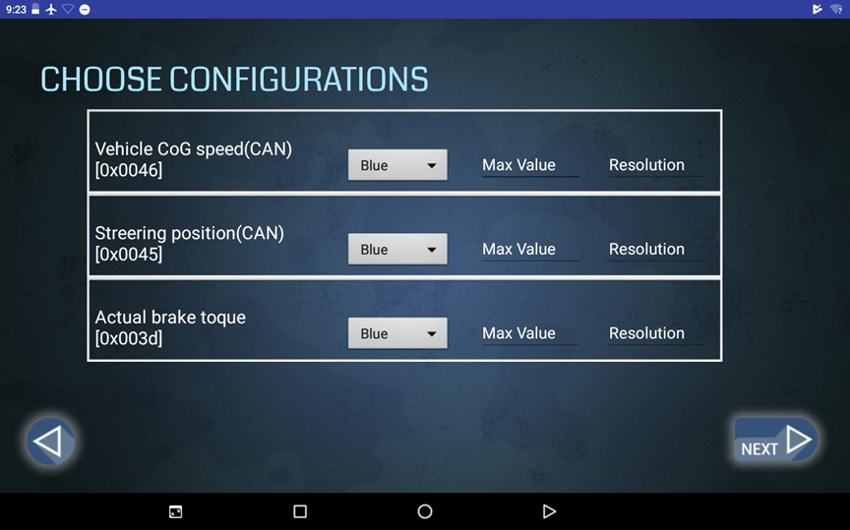
Live Conditions – Choose Configurations
Configurations according to user’s preferences.
Graph color
Max value
Resolution
If left empty, default configurations are used.

Slide 17
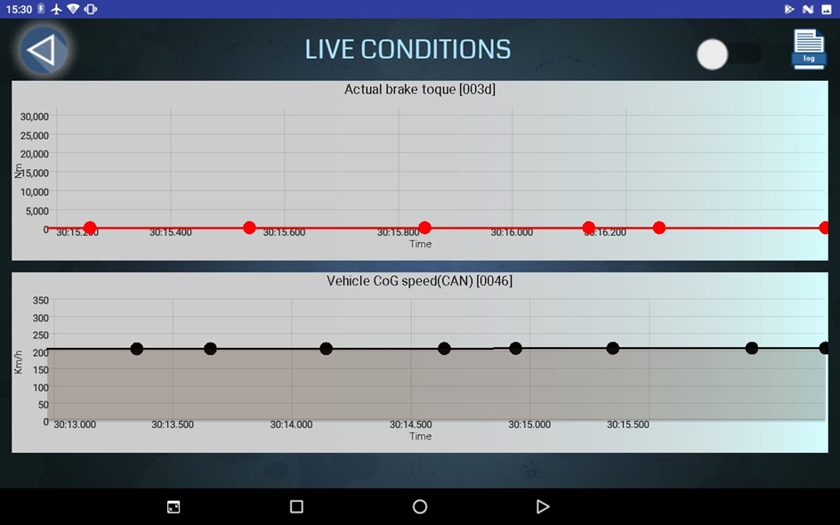
Live Conditions – Graphs
The actual live graphs.
On the top right-hand corner, the user can switch the logging option on/off.

Slide 18
Screens & Usage –
Options

Slide 19
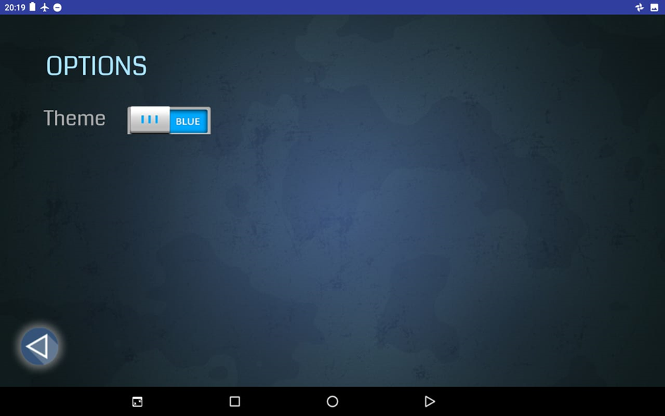
Options
Changing the theme of the app
Two options:
Red
Blue

Slide 20
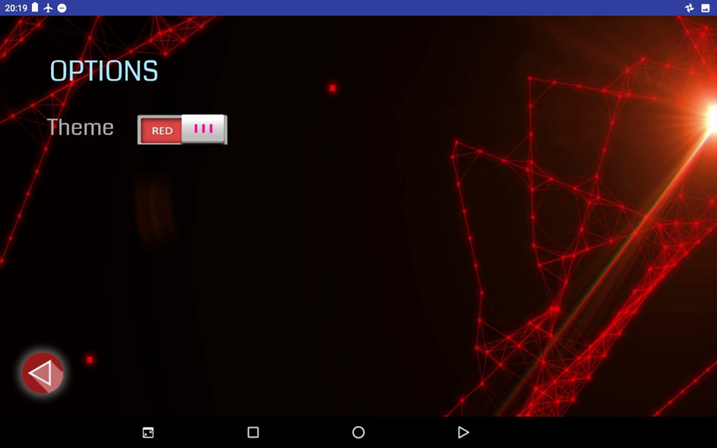
Options
Changing the theme of the app
Two options:
Red
Blue

Slide 21
Screens & Usage –
Log & Stats

Slide 22
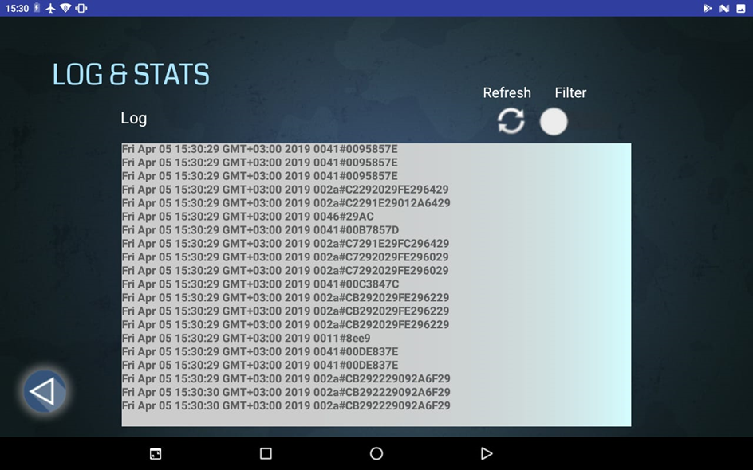
Log & Stats
View log recorded.
Filtering option according to the selected sensors.
Refresh button to update log view.

Slide 23
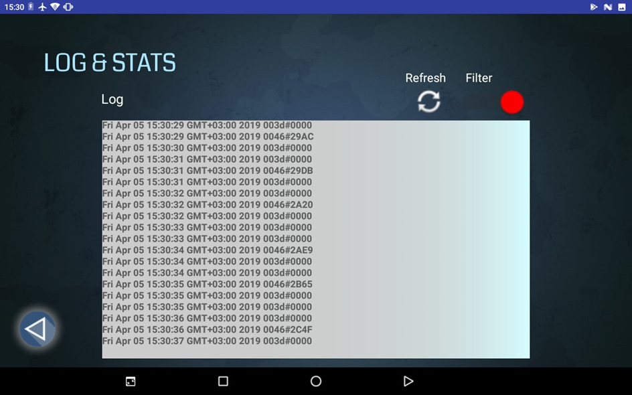
Log & Stats
View log recorded.
Filtering option according to the selected sensors.
Refresh button to update log view.

Slide 24
Screens & Usage –
Help & About

Slide 25
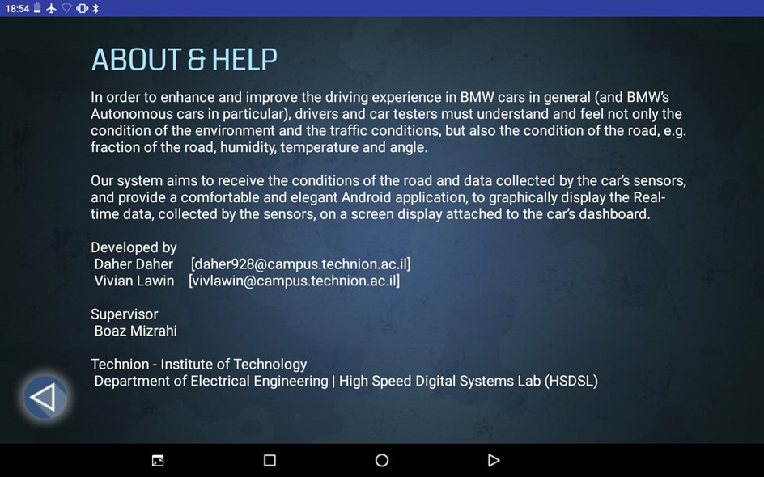
Help & About
A brief summary about the application.

Slide 26
Back-end - Transmitter
a Java application responsible for collecting the relevant data and transmitting them to the android application.
In order to do so, the Java Application sets up a connection over TCP
static final String androidId = "192.168.43.156";
static final int port = 9191;
static Socket socket;
static PrintWriter printwriter;
public static void setUpConnection(String Ip, int port){
socket = new Socket(Ip, port); // connect to server
printwriter = new PrintWriter(socket.getOutputStream(), true);
}

Slide 27
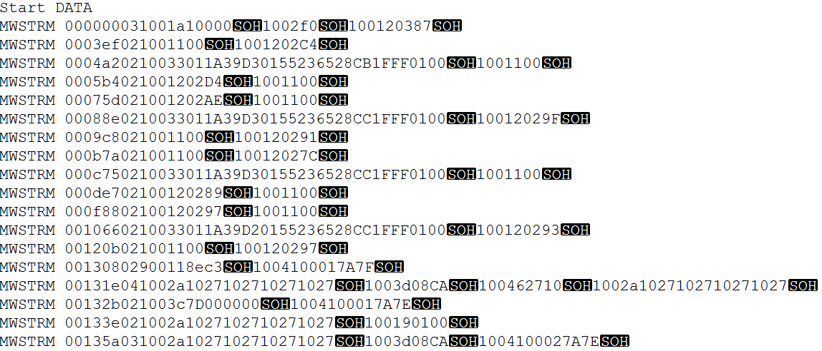
Back-end - Transmitter
Afterwards, the application proceeds to read the streams file written by the vehicle’s system.

Slide 28
Back-end - Transmitter
Streams File
Produced by vehicle’s system
Contains sensors data

Slide 29
Back-end - Transmitter
Streamline:
MWSTRM AAAAAA BB C DDDD HHHH…HHH [SOH] DDDD HHHH…HHH [SOH]…
Parsing:
AAAAAA – 6 Hexa digits representing the timestamp.
BB – 2 Hexa digits representing the number of samples in the streamline.
C – 1 Hexadecimal digit representing sample type (if not equal to 1, then we ignore the line).
DDDD – 4 Hexadecimal digits representing the sensor ID.
H…HHH – Hexadecimal digits representing the sample’s actual data.
SOH – Special character indicates an end of sample.

Slide 30
Back-end - Transmitter
Each line is parsed into a DataSample object and each sample in the DataSample is sent over the socket as a <SensorId#SensorVal>.
public class DataSample {
public int timeStamp;
public int samplesCount;
public List<String> sampleIds;
public List<String> samplesData;
}
------------------------------------------
DataSample ds = parseLine(line);
for(int i = 0; i < ds.samplesCount; i++) {
String sampleId = ds.sampleIds.get(i);
String sampleVal = ds.samplesData.get(i);
send(sampleId + "#" + sampleVal);
}

Slide 31
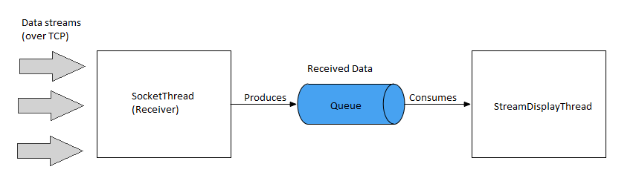
Back-end - Receiver
An Android application.
Composed of two main threads

Slide 32
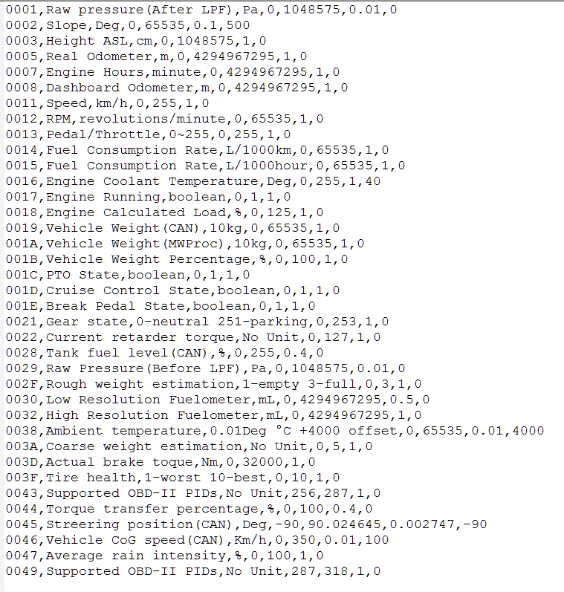
Back-end - Receiver
Sensor’s configurations file
CSV, comma separated file
Load on App start-up
Each line is parsed as follows:
<SensorId>, <SensorName>, <Units>, <minVal>, <maxVal>, <Resolution>, <Offset>

Slide 33
Back-end - Receiver
SocketThread
actual receiving of the data
setting up the other endpoint of the connection set by the transmitter
listens on port 9191 to incoming data in the format <SensorId#Value>
on receiving data message, in case the logging option is set ON, it logs it into a log file (bmwLog)
enqueues the data into a Producer-Consumer queue.

Slide 34
Back-end - Receiver
isr = new InputStreamReader(socket.getInputStream());
br = new BufferedReader(isr);
while((message = br.readLine()) != null){
handler.post(new Runnable() {
@Override
public void run() {
Timestamp ts = new Timestamp(System.currentTimeMillis());
Date d1 = new Date(ts.getTime());
String logText = d1 + " " + message + "\n";
if (AppState.isLogActive){
FileOutputStream fileOutputStream =
context.openFileOutput("bmwLog",
Context.MODE_APPEND);
fileOutputStream.write(logText.getBytes());
}
}
});
AppState.queue.add(message);
}

Slide 35
Back-end - Receiver
StreamDisplayThread
handling the data received
dequeues the data from the producer-consumer queue
handles the filtering and updating the graphs

Slide 36
Back-end - Receiver
while (!AppState.queue.isEmpty() && running) {
final String s = AppState.queue.poll();
...
if (!AppState.selectedIds.contains(id)){ //FILTERING
return;
}else{
final double double_val = Integer.valueOf(val, 16);
int graph_idx = AppState.selectedIds.indexOf(id);
int sid = AppState.selectedIds.get(graph_idx);
Sensor currSensor = AppState.getSensorFromId(sid);
double resolution = currSensor.getConfig().getResolution();
double offset = currSensor.getOffset();
double final_val = double_val * resolution + offset;
switch(graph_idx){
//UPDATE RELEVANT GRAPH
}
}
}
});

Slide 37
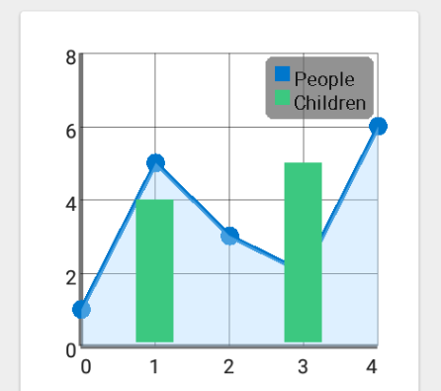
Back-end - Graph Generating
GraphView library.
programmatically create graphs and diagrams
Line Graphs, Bar Graphs, Point Graphs …
Key Features
Realtime / Live Chart
Tap listener
Scrolling and Scaling / Zooming
Customizable – color, thickness, label font …
And more …
Reference: https://github.com/jjoe64/GraphView

Slide 38
Intro to Part B

Slide 39
Intro to Part B
In Part A:
Consume “real-time” data. (But… from file produced by vehicles system)
A stepping stone and basis towards real-real-time

Slide 40
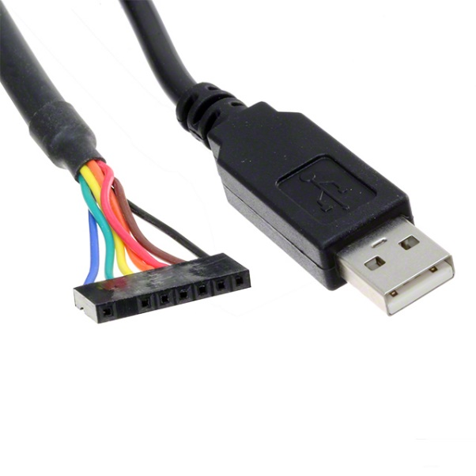
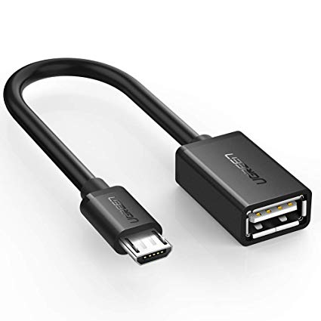
Intro to Part B
Part B – Goals & Features
Receive data directly from vehicles sensors
Profile per vehicle/user (login)
Cloud storage of test results and statistics.
Uart Cable OTG cable

Slide 41
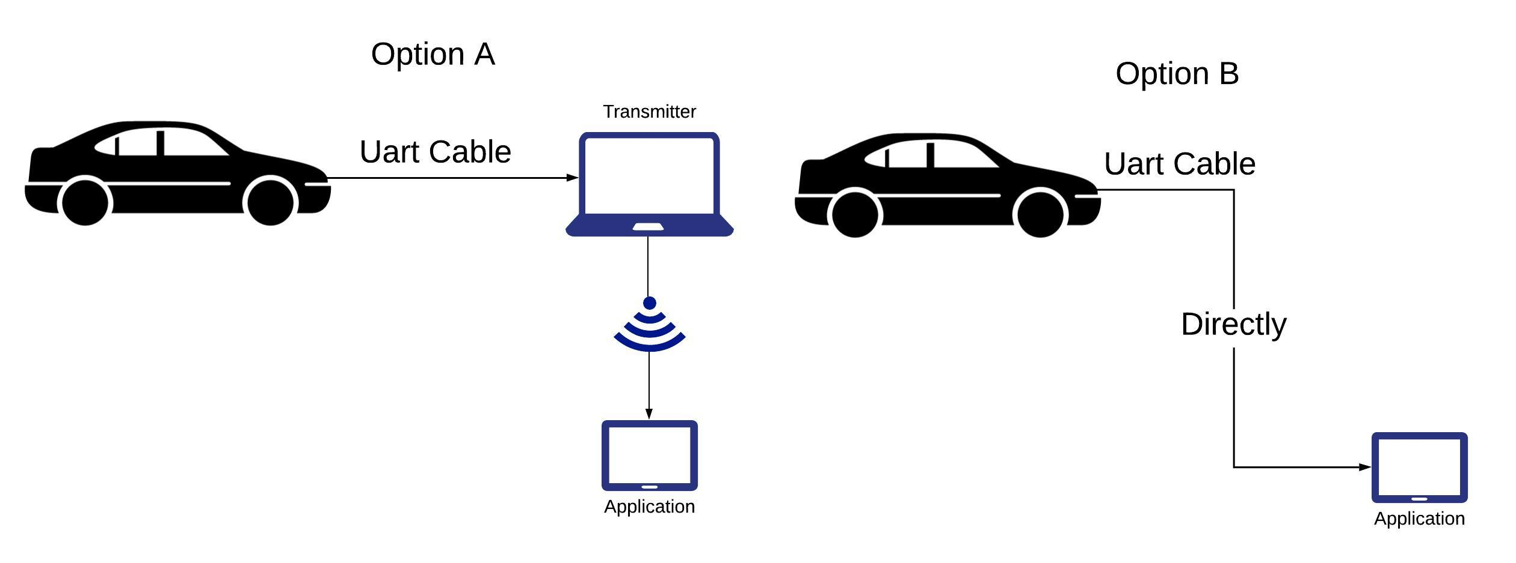
Intro to Part B
Do we get rid of the transmitter?

Slide 42
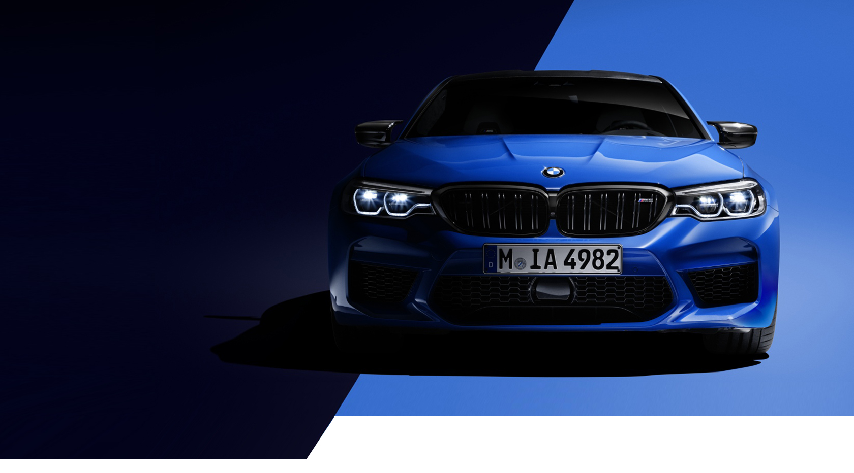
Thank You!
Buy me this☹
github.com/daher928/BMW_display_system_Part1

